Slide 1
CHAPTER 6 FUNCTIONS OF COMBINATIONAL LOGIC
组合逻辑电路函数

Slide 2
A 1-bit adder
Function: accepts two binary digits on its input and produces a sum bit and a carry bit.
0+0=0
0+1=1
1+0=1
1+1=10

Slide 3
Half-Adder 半加器
A | B |  | ∑ | C_{out}
0 | 0 |  | 0 | 0
0 | 1 |  | 1 | 0
1 | 0 |  | 1 | 0
1 | 1 |  | 0 | 1
Basic rules of binary addition are performed by a half adder, which has two binary inputs (A and B) and two binary outputs (Carry out and Sum).
Bool equation:
∑ = AB’ + A’B = A⊕B
C_{out}=AB

Slide 4
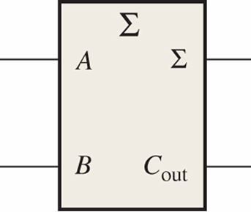
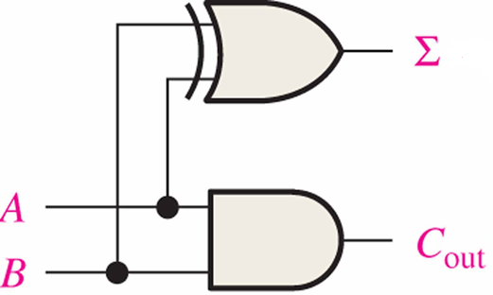
Half-Adder
∑ = AB’ + A’B = A⊕B
C_{out}=AB
The logic symbol and equivalent circuit are:

Slide 5
n-bit Addition ?
The addition of two n-bit binary numbers generates a n-bit sum and a carry out.
Example: let n = 4, caculate 1101+1101.
Two input bits and one input carry
1 | 1 | 0 | 1 | 0
 | 1 | 1 | 0 | 1
+ | 1 | 1 | 0 | 1
 | 1 | 0 | 1 | 0
C_{out} | C₃ | C₂ | C₁ | C₀
 | A₃ | A₂ | A₁ | A₀
+ | B₃ | B₂ | B₁ | B₀
 | S₃ | S₂ | S₁ | S₀

Slide 6
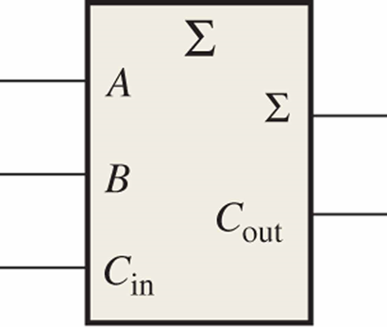
Full-Adder 全加器
A
B
C_{in}
∑
C_{out}
0
0
0
0
0
By contrast, a full adder has three binary inputs (A, B, and Carry in) and two binary outputs (Carry out and Sum). The truth table summarizes the operation.
0
0
1
1
0
0
1
0
1
0
0
1
1
0
1
1
0
0
1
0
1
0
1
0
1
1
1
0
0
1
1
1
1
1
1

Slide 7
Full-Adder
00
01
11
10
00
01
11
10
BC_{in}
BC_{in}
A
A
0
0
0
0
1
0
0
1
0
1
1
1
0
1
1
1
1
0
1
0
C_{out} = AB + AC_{in} + BC_{in}
∑ = AB’ C_{in}’ + A’B’C_{in} + A’BC_{in}’ +ABC_{in} = A⊕B⊕C_{in}

Slide 8
2HA->FA
A full-adder can be constructed from two half adders:
C_{out} = AB + A B’ C_{in} + A’ BC_{in}
= AB + (AB’ + A’ B) C_{in} = AB + (A ⊕ B) C_{in}
∑ = A⊕B⊕C_{in}
HA
HA

Slide 9
Full-Adder
E.g. For the given inputs, determine the intermediate and final outputs of the full adder.
Solution:
The first half-adder has inputs of 1 and 0; therefore the Sum =1 and the Carry out = 0.
The second half-adder has inputs of 1 and 1; therefore the Sum = 0 and the Carry out = 1.
The OR gate has inputs of 1 and 0, therefore the final carry out = 1.
Σ
Σ
0
Sum
1
A
Σ
1
A
Σ
B
0
1
0
C_{out}
B
C_{out}
1
C_{out}
1

Slide 10
n-bit Combinational Adders
Full adders are combined into parallel adders(并行加法器) that can add binary numbers with multiple bits.
Ripple Carry Adder(行波进位加法器 )
Simple design / Time consuming.
Carry Look ahead Adder (先行进位加法器)
More complex / Reduces circuit delay

Slide 11
Ripple Carry Adder 行波进位加法器
A ripple carry adder is one in which the carry output of each full-adder is connected to the carry input of the next higher-order state.
C_{out} | C₃ | C₂ | C₁ | C₀
 | A₃ | A₂ | A₁ | A₀
+ | B₃ | B₂ | B₁ | B₀
 | S₃ | S₂ | S₁ | S₀

Slide 12
Carry Look ahead Adder 先行进位加法器
One method of speeding up the addition process by eliminating this ripple carry delay is called look-ahead carry addition.
Consider：C_{i+1} = A_{i}B_{i} + (A_{i} ⊕ B_{i}) C_{i}
Carry generation(进位产生)：
Let G_{i} = A_{i}B_{i}= 1，if G_{i}=1，then C_{i+1}=1
Carry propagation(进位传递)：
Let P_{i} = A_{i} ⊕ B_{i} ，if P_{i}=1，then C_{i+1}=C_{i}

Slide 13
Carry Look ahead Adder
C_{i+1} = G_{i} + P_{i}C_{i}
Base on this ayalysis:
C₁ = G₀+P₀ C₀
C₂ = G₁+P₁C₁ = G₁+P₁(G₀+P₀C₀) = G₁+P₁G₀+P₁P₀C₀
C₃ = G₂ + P₂C₂ = G₂+P₂G₁+P₂P₁G₀+P₂P₁P₀C₀
C₄ = G₃+P₃G₂+P₃P₂G₁+P₃P₂P₁G₀ + P₃P₂P₁P₀ C₀
……
Now the ripple problem is solved
Carry generation
Carry propagation

Slide 14
A 4-bit Carry Look ahead Adder

Slide 15
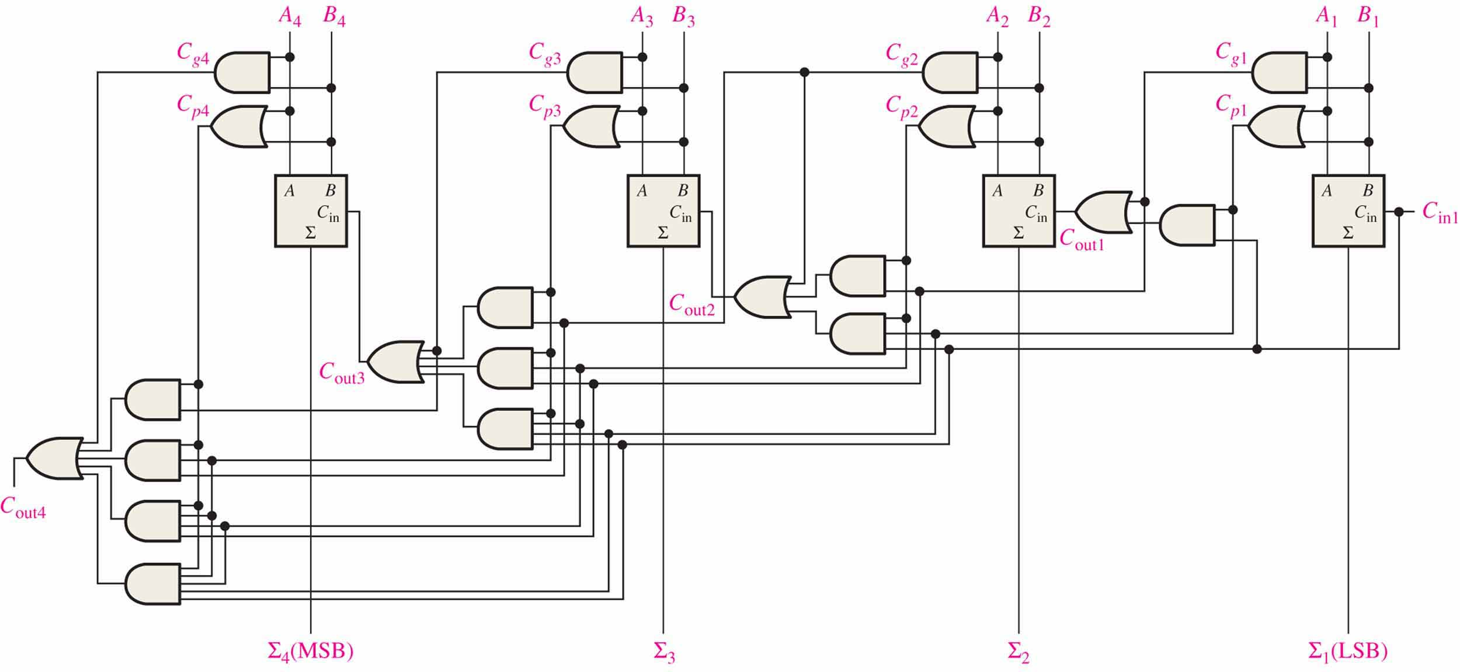
A 4-bit Carry Look ahead Adder

Slide 16
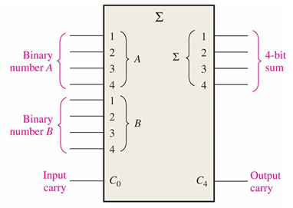
A 4-bit Adders
The logic symbol for a 4-bit parallel adder is shown. This 4-bit adder includes a carry in (labeled C₀) and a Carry out (labeled C₄).

Slide 17
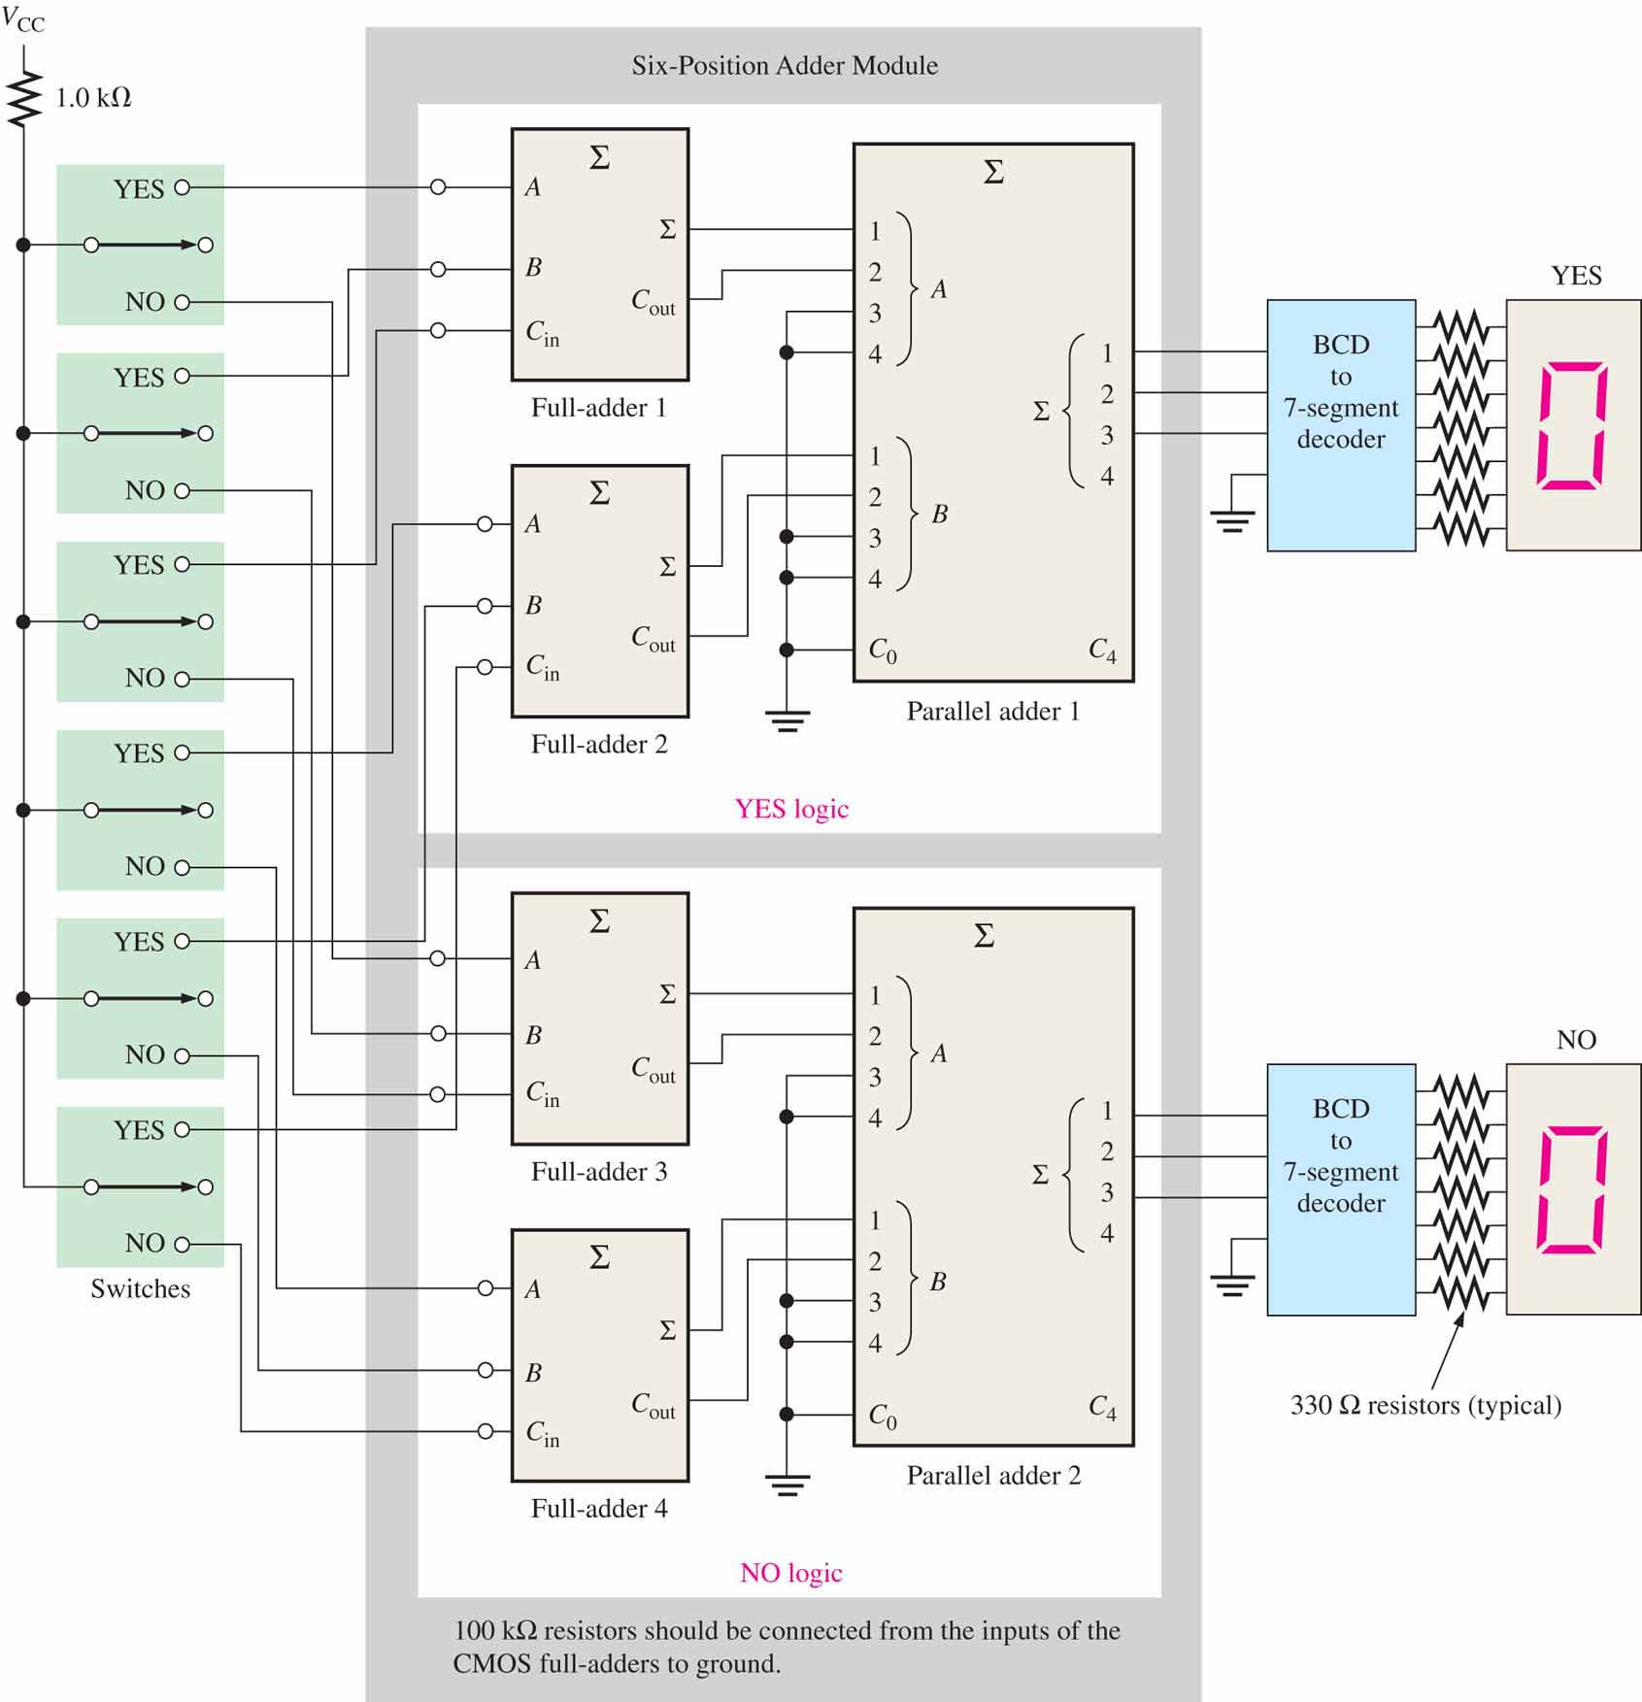
An application: a voting system
A simple voting system that can be used to simultaneously provide the number of “yes” votes and the number of “no” votes.

Slide 18
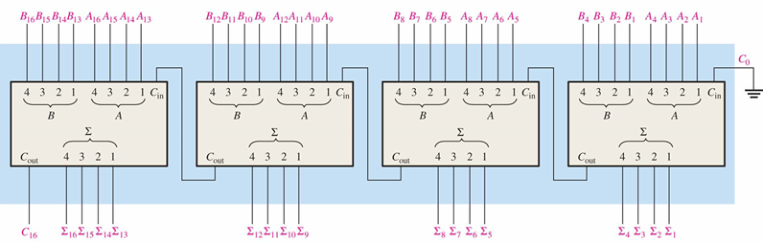
An application: Cascading four 74LS283 four-bit adders to form 1 16bit adder

Slide 19
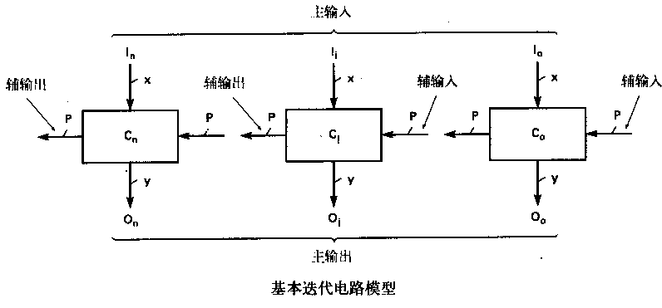
Iterative design
Primary Input/Output: 主输入/输出
Secondary Input/Output: 辅输入/输出
The technique of designing a single cell, each with a set of inputs and outputs, and then cascading the cells to form larger circuits is called iterative design.
Basic iterative circuit model

Slide 20
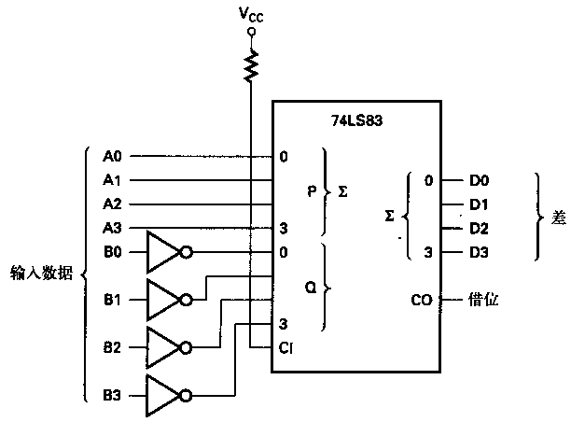


An application：Subtractor
Using 2’s complement to realize subtraction
E.g. A=0,1001, B=0,0011.
$$\frac{\begin{matrix} & 0,1001 \\ + & 1,1101\end{matrix}}{\begin{matrix} & 0,0110\end{matrix}}$$
$$\frac{\begin{matrix} & 0,1001 \\ − & 0,0011\end{matrix}}{\begin{matrix} & 0,0110\end{matrix}}$$

Slide 21
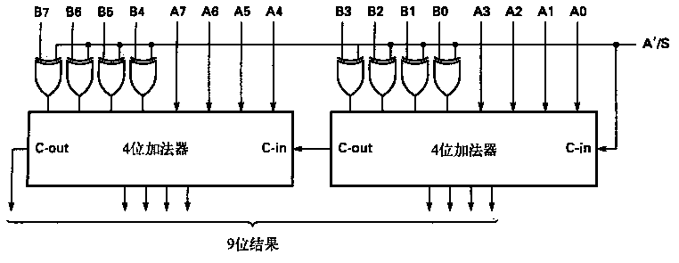
An application： an adder/subtractor circuit
A’/S is the mode control. How does it work?
When the A’/S mode control input is a 0 the EX-OR gates do not invert, so the input data are added unchanged. The carry-in bit is forced to logic 0.
A⊕0=A
A⊕1=A’

Slide 22
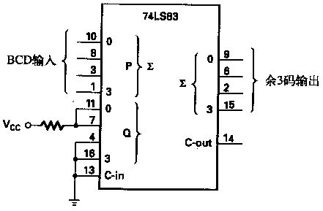
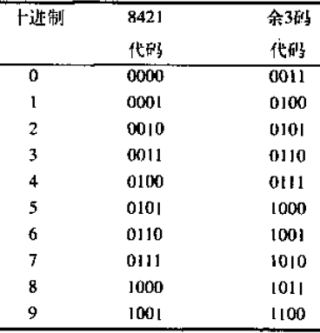
An application：a BCD to Excess-3 code converter

Slide 23
An application：BCD Adder
BCD Decimal Adder:
Requires 8 inputs (4 bits per decimal number)
5 outputs indicate the decimal sum and the carry
Remember BCD addition rules: Add 0110 to the sum if it is greater than 1010 to correct the carry bit

Slide 24
An application：BCD Adder
e.g.：Let A=1000，B=0111。The BCD sum of A+B is (1)0101
 | 1 | 0 | 0 | 0
+ | 0 | 1 | 1 | 1
 | 1 | 1 | 1 | 1
 |  | 1 | 1 | 1 | 1
+ |  | 0 | 1 | 1 | 0
 | 1 | 0 | 1 | 0 | 1
Why plus 6?

Slide 25
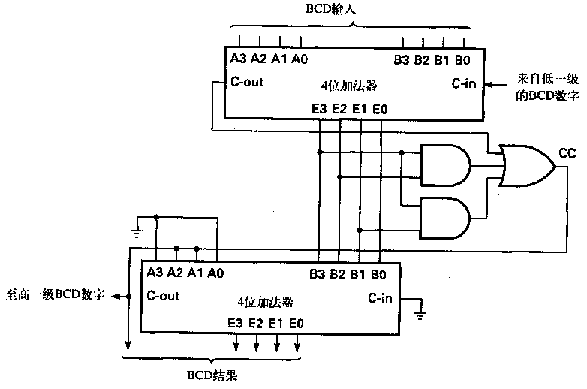
An application：BCD Adder
From lower order BCD digits.
To higher order BCD digits.

Slide 26
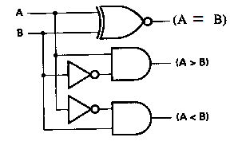
Comparators
The function of a comparator is to compare the magnitudes of two binary numbers to determine the relationship between them.
A | B | A=B | A>B | A<B
0 | 0 | 1 | 0 | 0
0 | 1 | 0 | 0 | 1
1 | 0 | 0 | 1 | 0
1 | 1 | 1 | 0 | 0
Single bit comparator
A EQ B = A’B’ + AB
A > B = AB’
A< B = A’B
How about 4-bit comparator?

Slide 27
Comparators
A₃ B₃ A₂ B₂ A₁ B₁ A₀ B₀ | F_{A＞B} F_{A＜B} F_{A＝B}
A₃＞B₃ × × × A₃＜B₃ × × × A₃＝B₃ A₂＞B₂ × × A₃＝B₃ A₂＜B₂ × × A₃＝B₃ A₂＝B₂ A₁＞B₁ × A₃＝B₃ A₂＝B₂ A₁＜B₁ × A₃＝B₃ A₂＝B₂ A₁＝B₁ A₀＞B₀ A₃＝B₃ A₂＝B₂ A₁＝B₁ A₀＜B₀ A₃＝B₃ A₂＝B₂ A₁＝B₁ A₀＝B₀ | 1 0 0 0 1 0 1 0 0 0 1 0 1 0 0 0 1 0 1 0 0 0 1 0 0 0 1

Slide 28
Comparators

Slide 29
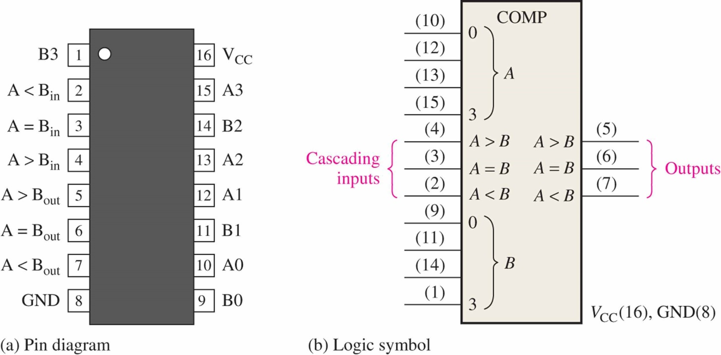
Comparators
IC comparators provide outputs to indicate which of the numbers is larger or if they are equal. The bits are numbered starting at 0, rather than 1 as in the case of adders. Cascading inputs are provided to expand the comparator to larger numbers.
The IC shown is the 4-bit 74LS85.

Slide 30
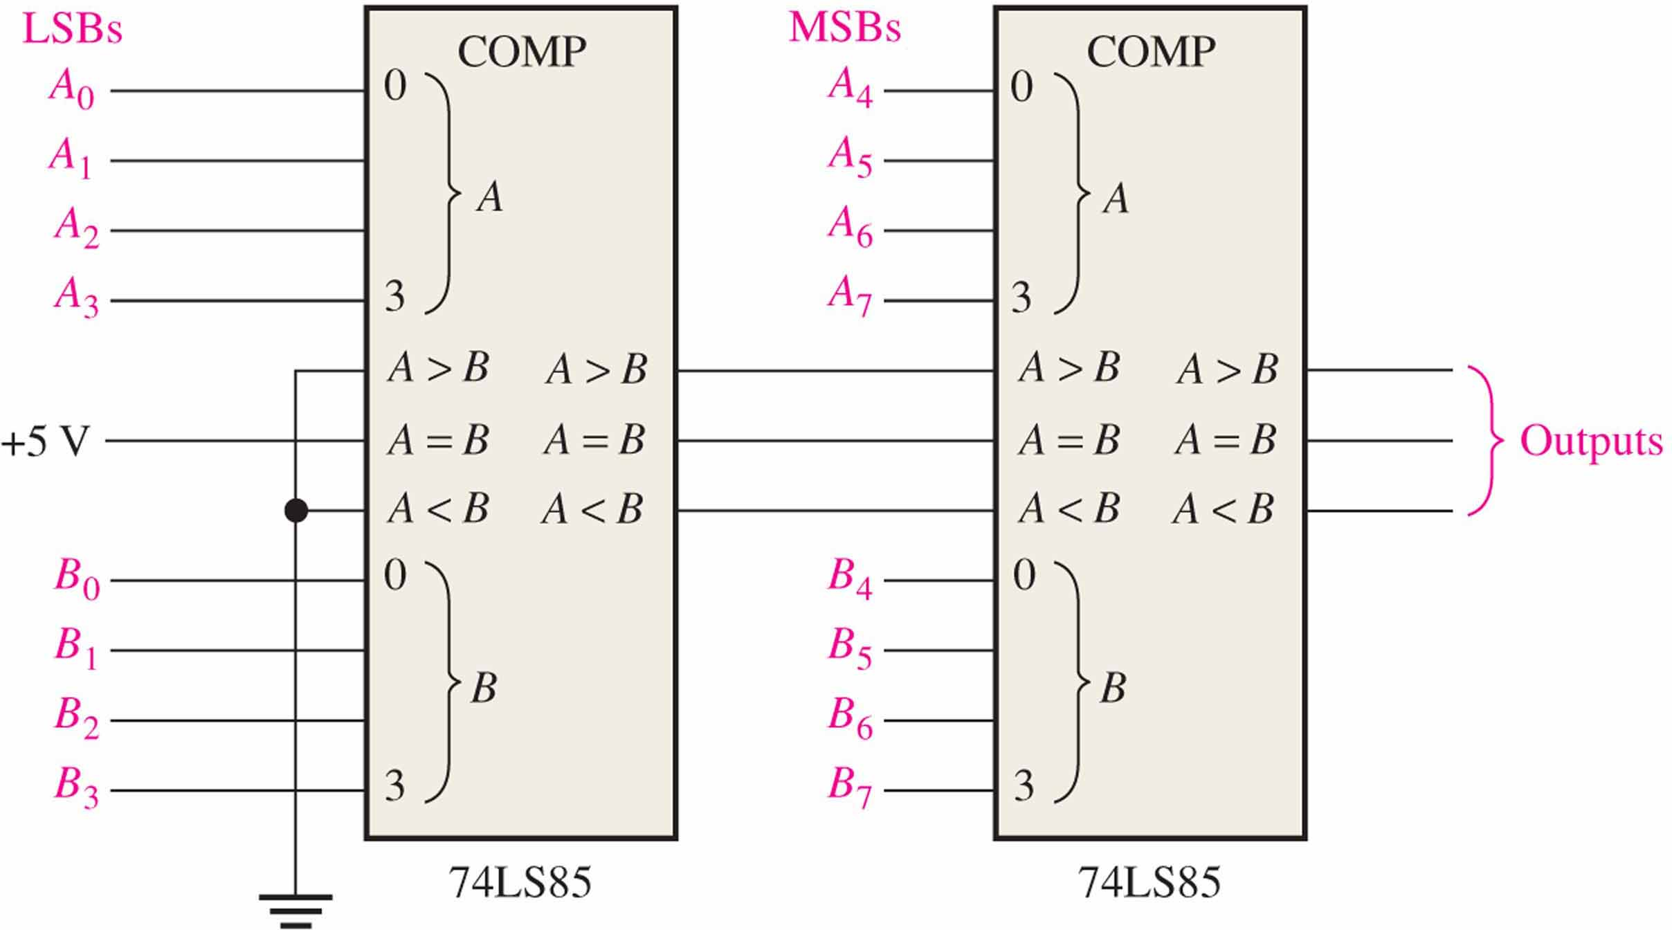
Comparators
IC comparators can be expanded using the cascading inputs as shown. The lowest order comparator has a HIGH on the A = B input.

Slide 31
Decoders 译码器
A decoder is a logic circuit that detects the presence of a specific combination of bits at its input. Two simple decoders that detect the presence of the binary code 0011 are shown. The first has an active HIGH output; the second has an active LOW output.
A₀
A₀
A₁
X
A₁
X
A₂
A₂
A₃
A₃
Active HIGH decoder for 0011
Active LOW decoder for 0011

Slide 32
Decoders
E.g. Assume the output of the decoder shown is a logic 1. What are the inputs to the decoder?

Slide 33
Decoders
IC decoders have multiple outputs to decode any combination of inputs.
n-to-2^{n} decoder
n-to-m decoder, m ≤ 2^{n}
E.g.
3-line-to-8-line decoder (3线-8线译码器)
BCD-to-decimal decoder, where n=4 and m=10

Slide 34
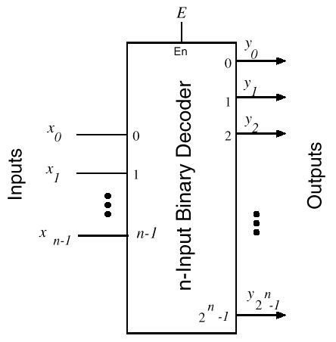
Decoders

Slide 35
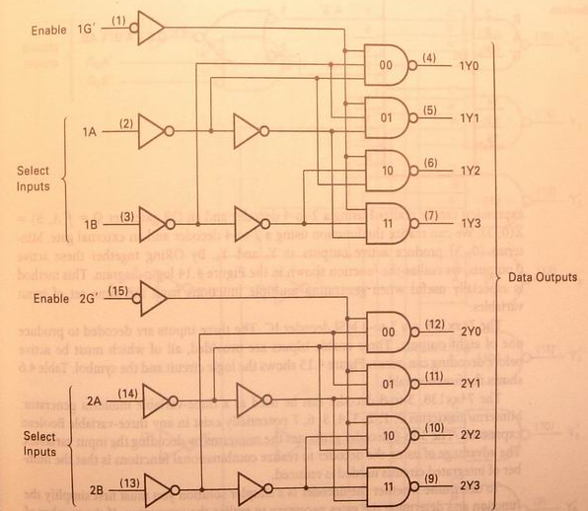
Decoders
Y₀=(G’B’A’)’=G+B+A
Y₁=(G’B’A)’=G+B+A’
Y₂=(G’BA’)’=G+B’+A
Y₃=(G’BA)’=G+B’+A’
74xx139 decoder

Slide 36
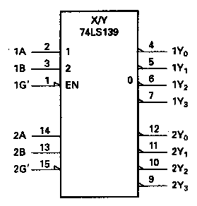
Decoders(74xx139 decoder)
Input |  |  | Output
Enable | Select
G’ | B | A | Y0 | Y1 | Y2 | Y3
H | X | X | H | H | H | H
L | L | L | L | H | H | H
L | L | H | H | L | H | H
L | H | L | H | H | L | H
L | H | H | H | H | H | L
Y₀=(G’B’A’)’=G+B+A
Y₁=(G’B’A)’=G+B+A’
Y₂=(G’BA’)’=G+B’+A
Y₃=(G’BA)’=G+B’+A’

Slide 37
3-to-8 Decoder (74xx138)
Three inputs, A₀, A₁, A₂, are decoded into eight outputs, Y₀ through Y₇
Each output Y_{i} represents one of the minterms of the 3 input variables.
Shorthand: Y_{i} = m_{i}
The output variables are mutually exclusive; exactly one output has the value 1 at any time, and the other seven are 0.
Y_{i} = 1 when the binary number A₂A₁A₀ = i

Slide 38
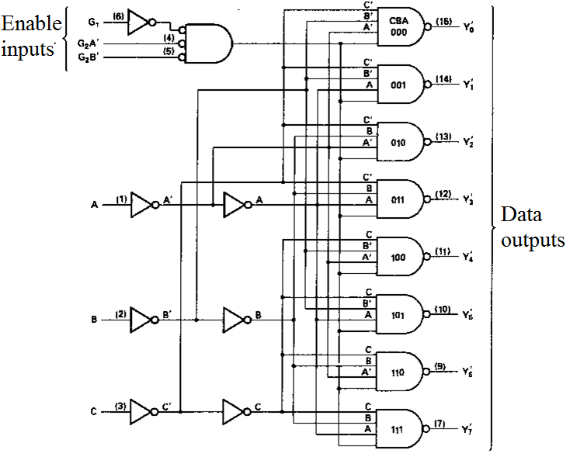
3-to-8 Decoder (74xx138)
Y₀’=(C’B’A’)’=m₀’
Y₁’=(C’B’A)’=m₁’
Y₂’=(C’BA’)’=m₂’
Y₃’=(C’BA)’=m₃’
Y₄’=(CB’A’)’=m₄’
Y₅’=(CB’A)’=m₅’
Y₆’=(CBA’)’=m₆’
Y₇’=(CBA)’=m₇’
Ignore the enable inputs

Slide 39
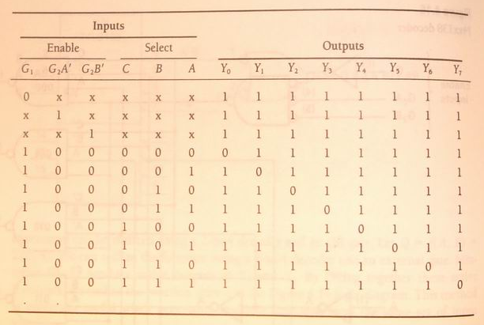
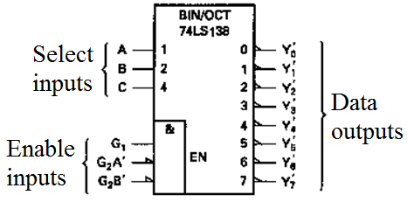
3-to-8 Decoder (74xx138)
Truth table
IEEE logic symble.

Slide 40
Decoders
E.g. A 4-to-16 decoder shown here has 16 outputs – one for each combination of binary inputs.
For the input shown, what is the output?

Slide 41
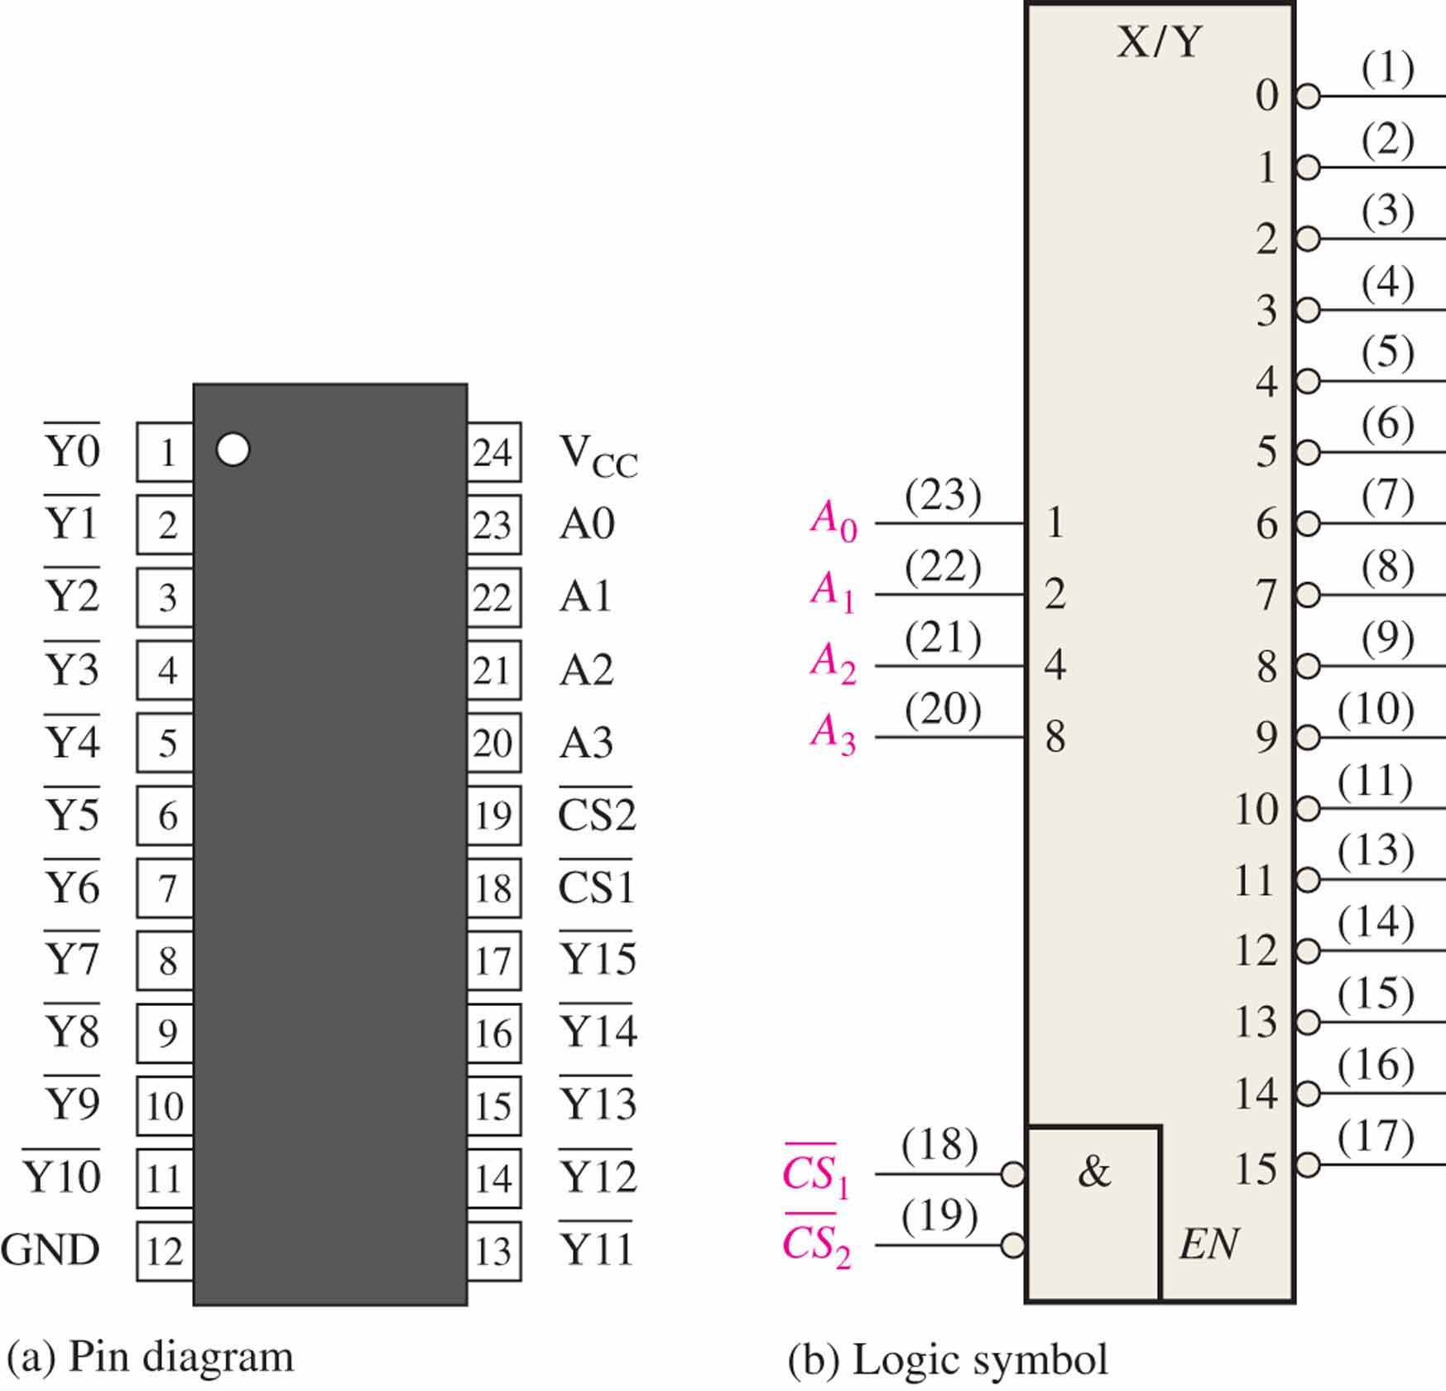
Decoders
A specific integrated circuit decoder is the 74HC154 (shown as a 4-to-16 decoder). It includes two active LOW chip select lines which must be at the active level to enable the outputs. These lines can be used to expand the decoder to larger inputs.

Slide 42
Decoder Expansions
Larger decoders can be constructed using a number of smaller ones.
HIERARCHICAL design（层次设计)
Example:
A 4-to-16 decoder can be designed using two 3-to-8 decoders.
A 6-to-64 decoder can be designed using four 4-to-16 and one 2-to-4 decoders. How? (Hint: Use the 2-to-4 decoder to generate the enable signals to the four 4-to-16 decoders).

Slide 43
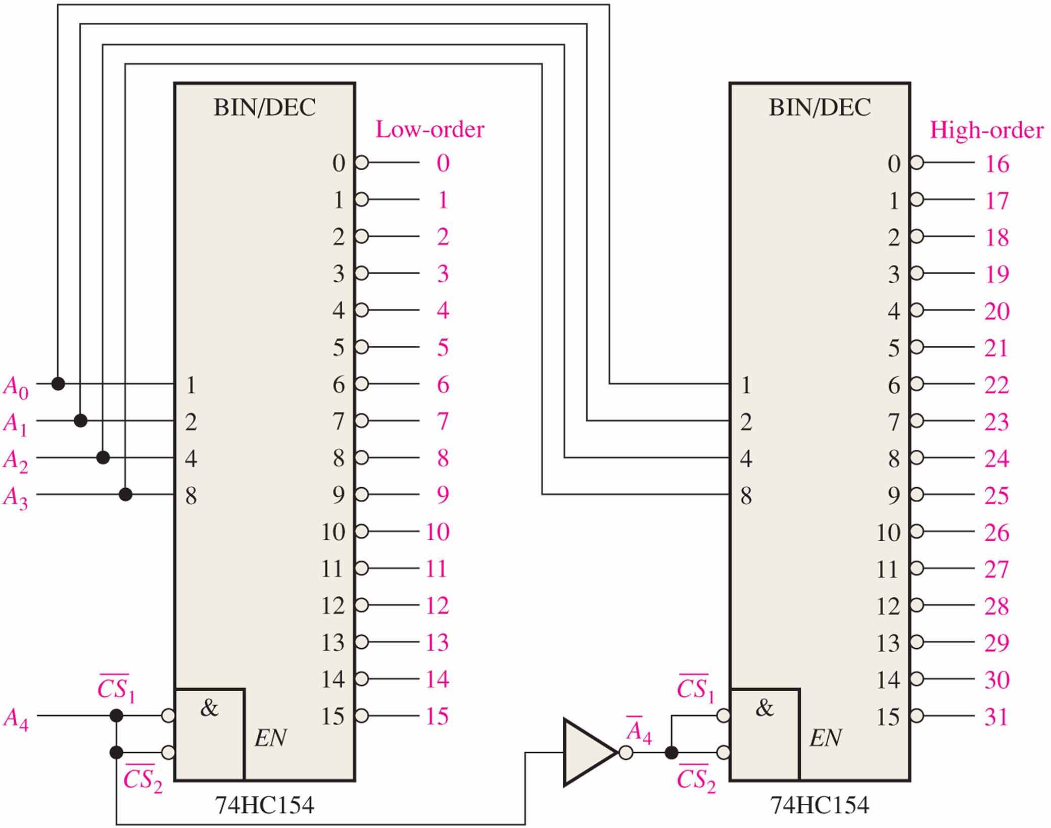
Decoders Expansions
A 5-bit decoder using 74HC154s

Slide 44
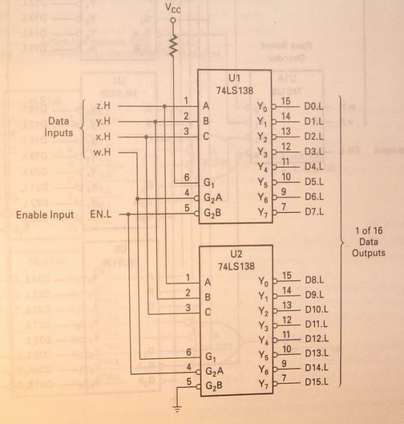
Decoders Expansions
Two 74XX138 decoders forming a single 4-to-16 decoder

Slide 45
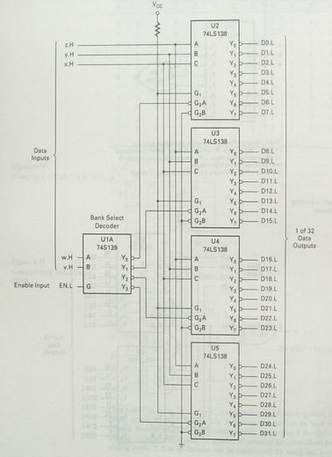
Decoders Expansions
A 5-to-32 decoder using one 2-to-4 and four 3-to-8 decoder ICs
A 6-to-64 decoder can be designed using four 4-to-16 and one 2-to-4 decoders. How?

Slide 46
Implementing Boolean functions using decoders
E.g. use 74XX138, 3-to-8 decoder to implement boolean functions
Y₁ = A’B’+AC+A’C’
Y₂ = A’C+AC’
Y₃ = B’C+BC’
Solution:
Y₁ = A’B’+AC+A’C’= m₀+m₁+m₂+m₅+m₇ = (m₀’m₁’m₂’m₅’m₇’)’
Y₂ = A’C+AC’ = m₁+m₃+m₄+m₆ = (m₁’m₃’m₄’m₆’)’
Y₃ = B’C+BC’ = m₁+m₂+m₅+m₆ = (m₁’m₂’m₅’m₆’)’

Slide 47
Implementing Boolean functions using decoders
Y₁ = (m₀’m₁’m₂’m₅’m₇’)’
Y₂ = (m₁’m₃’m₄’m₆’)’
Y₃ = (m₁’m₂’m₅’m₆’)’

Slide 48
Implementing Boolean functions using decoders
Y₁ = A’B’+AC+A’C’= m₀+m₁+m₂+m₅+m₇ = ∑(0,1,2,5,7) = ∏(3,4,6)=M₃M₄M₆=m₃’m₄’m₆’
Y₂ = A’C+AC’ = m₁+m₃+m₄+m₆ = ∑(1,3,4,6) = m₀’m₂’m₅’m₇’
Y₃ = B’C+BC’ = m₁+m₂+m₅+m₆ = ∑(1,2,5,6) = m₀’m₃’m₄’m₇’

Slide 49
Implementing Boolean functions using decoders
Y₁=m₃’m₄’m₆’
Y₂=m₀’m₂’m₅’m₇’
Y₃=m₀’m₃’m₄’m₇’

Slide 50
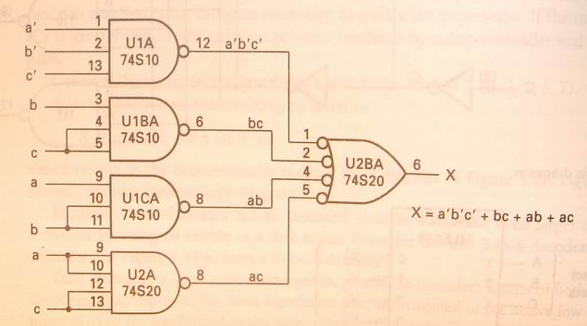
Implementing Boolean functions using decoders
E.g. X=f(a,b,c)=∑(0,3,5,6,7)
=a’b’c’+ab+bc+ac

Slide 51
Implementing Boolean functions using decoders
Exe. Using decoders realize functions
A = f(x,y,z) = ∏(0,1,3,5)
G=f(x,y,z)=∑(0,1,2,4,5,6,7)

Slide 52
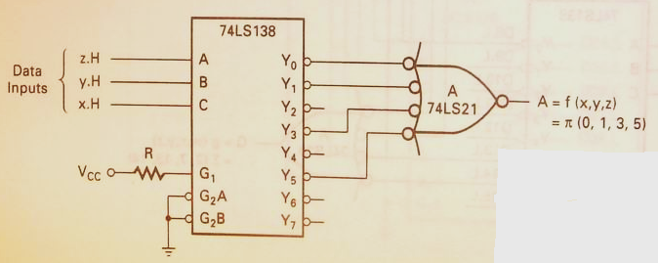
Implementing Boolean functions using decoders
A = f(x,y,z) = ∏(0,1,3,5)

Slide 53
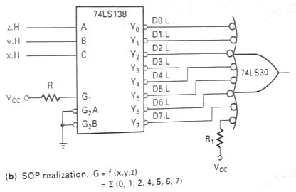
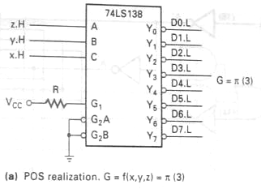
Implementing Boolean functions using decoders
G=f(x,y,z)=∑(0,1,2,4,5,6,7)

Slide 54
Implementing Boolean functions using decoders
use 74HC154 to implement F(A, B, C, D) = Σm(1,2,5,7)

Slide 55
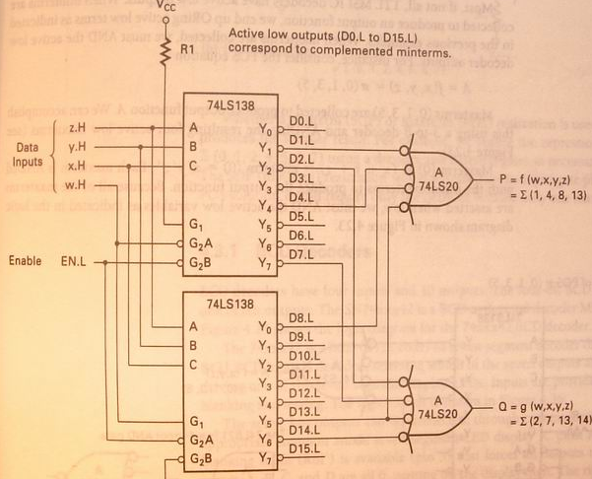
Implementing Boolean functions using decoders
E.g. Using two 74XX138 decoders to realize a four-variable multiple output function
P = f(w,x,y,z) =∑(1, 4, 8, 13)
Q = f(w,x,y,z) =∑(2, 7, 13, 14)

Slide 56
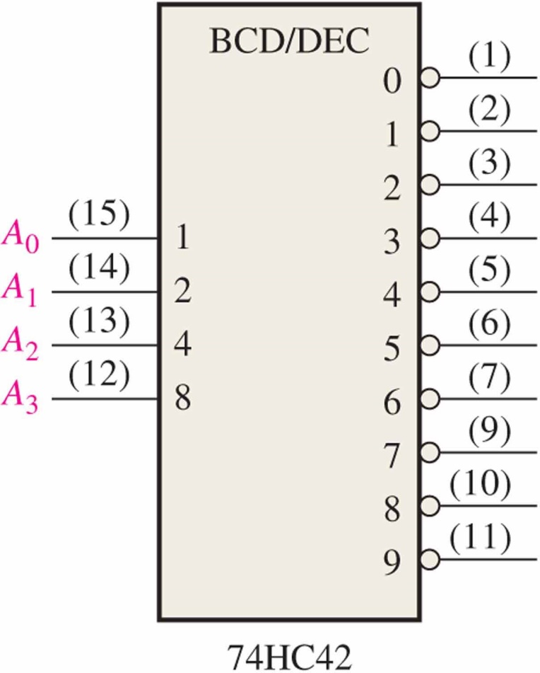
Decoders
BCD-to-decimal decoders accept a binary coded decimal input and activate one of ten possible decimal digit indications.
E.g. Assume the inputs to the 74HC42 decoder are the sequence 0101, 0110, 0011, and 0010. Describe the output.
Solution: All lines are HIGH except for one active output, which is LOW. The active outputs are 5, 6, 3, and 2 in that order.

Slide 57
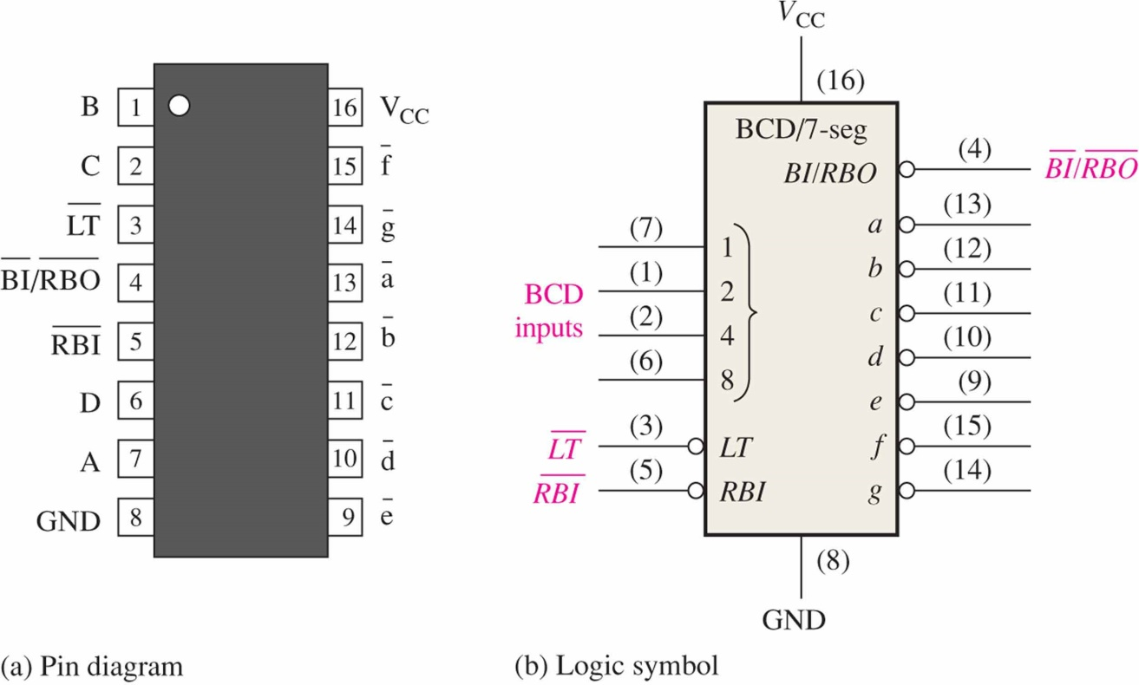
BCD Decoder/Driver
Another useful decoder is the 74LS47. This is a BCD-to-seven segment display with active LOW outputs. （P193)
*The a-g outputs are designed for much higher current than most devices (hence the word driver in the name).
Outputs to seven segment device

Slide 58
BCD Decoder/Driver
Here the 7447A is an connected to an LED seven segment display. Notice the current limiting resistors, required to prevent overdriving the LED display.

Slide 59

BCD Decoder/Driver
The 74LS47 features leading zero suppression, which blanks unnecessary leading zeros but keeps significant zeros as illustrated here. The $\overline{\text{B}\text{I} }/\overline{\text{RBO}}$ output is connected to the $\overline{\text{RBI} }$ input of the next decoder.
Illustration of leading zero suppression
整数的头部灭0逻辑框图
Blanked
Blanked
Depending on the display type, current limiting resistors may be required.

Slide 60

BCD Decoder/Driver
Trailing zero suppression blanks unnecessary trailing zeros to the right of the decimal point as illustrated here. The $\overline{\text{RBI} }$ input is connected to the $\overline{\text{BI} }/\overline{\text{RBO}}$ output of the following decoder.
Illustration of trailing zero suppression
小数的尾部灭0逻辑框图
Decimal point
Blanked
Blanked

Slide 61
HOMEWORK
use decoder to implement boolean functions
X = f(a,b,c) = ∑(2,5) Y = f(a,b,c) = ∑(3,5,6)
P = f(w,x,y,z) = ∑(0,5,11)
D = f(a,b,c) = ∏(3,5,7)
F = f(w,x,y,z) = ∏(1,7,13,15)

